Slide 1


EV Vehicle Charge Demand Prediction
Name:- Tanishq Rajendra Hadke
Student ID:- STU6633c632c5f9c1714669106
AICTE Internship ID:-INTERNSHIP_1748923002683e727a876ea

Slide 2

Learning Objectives
Identify the gap due to the absence of accurate EV adoption forecasting models at the county level
Learn to apply machine learning techniques to real-world energy and transportation datasets
Develop skills in data preprocessing, feature selection, and model training
Evaluate different ML algorithms to find the most suitable for EV adoption prediction
Contribute to sustainable infrastructure planning using predictive analytics
GOAL
Source :
www.freepik.com/

Slide 3
Tools and Technology used
Development Environment
Visual Studio Code
Python Kernel:3.13.3
Machine Learning
sklearn.preprocessing.LabelEncoder
sklearn.ensemble.RandomForestRegressor
sklearn.model_selection.train_test_split
sklearn.model_selection.RandomizedSearchCV
sklearn.metrics
Core Python Libraries
numpy
pandas
datetime
Web App Deployment
streamlit
Data Visualization
matplotlib.pyplot
seaborn
Model Serialization
joblib
Data-Set
Kaggle

Slide 4
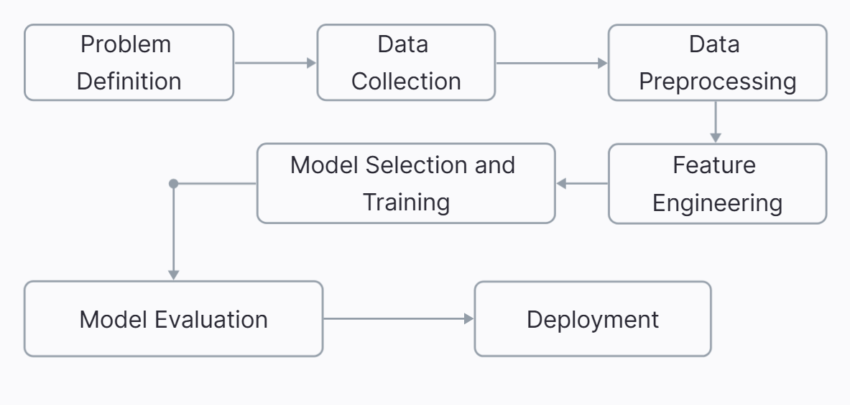
Methodology

Slide 5
Problem Statement:
There is no accurate, localized forecasting model to predict future EV adoption in Washington State counties, making it difficult for policymakers and utility planners to allocate infrastructure and resources efficiently.
Without county-level forecasts, decisions regarding EV charging station placement, grid capacity planning, and incentive distribution are often based on assumptions or generalized state-level data. This can lead to underprepared infrastructure in high-growth regions and resource wastage in areas with slower adoption.

Slide 6
Solution:
To address this gap, we developed a machine learning–based forecasting model tailored to predict EV adoption at the county level in Washington State.
Using historical EV registration data, demographic indicators, income levels, charging infrastructure availability, and energy prices, the model learns patterns and projects future adoption trends. We used a Random Forest Regressor optimized through hyperparameter tuning to ensure high accuracy and generalization.
The final model was deployed using streamlit as an interactive web application, enabling policymakers, planners, and stakeholders to input variables and obtain localized EV adoption forecasts, empowering data-driven infrastructure planning and sustainable policy development.
GIT HUB LINK FOR THE PROVIDED SOLUTION
https://github.com/Tanishq-Hadke/Internship-AI-ev-AICT

Slide 7
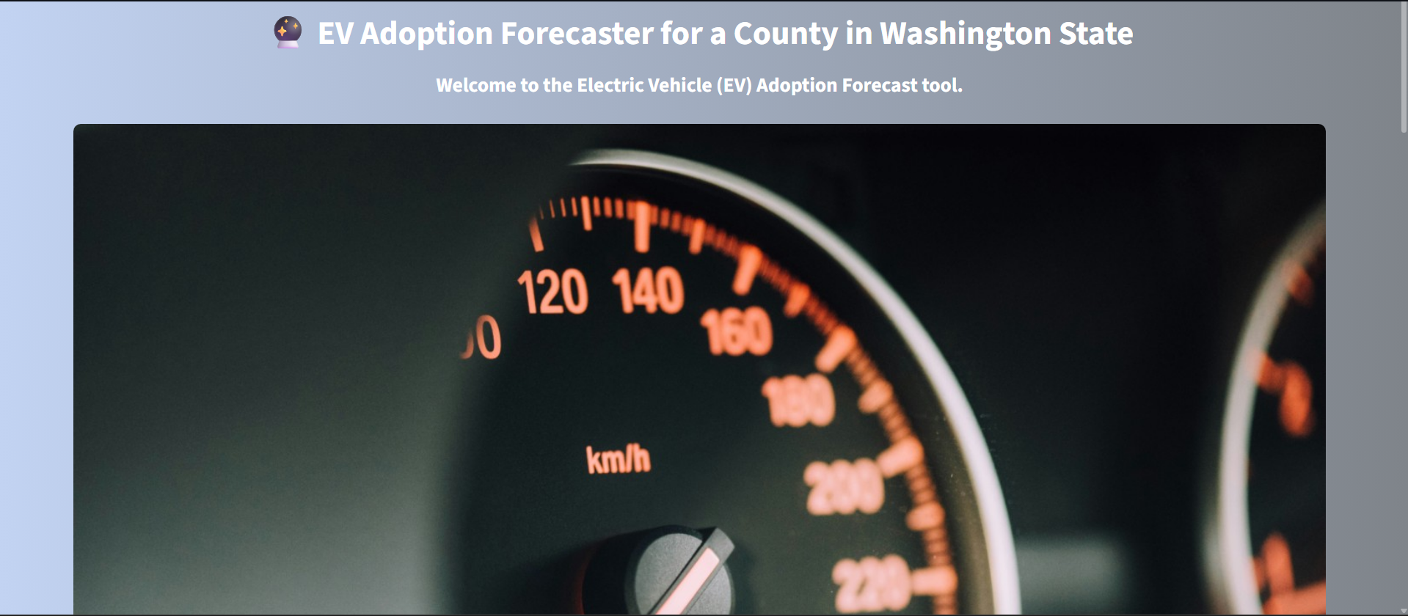
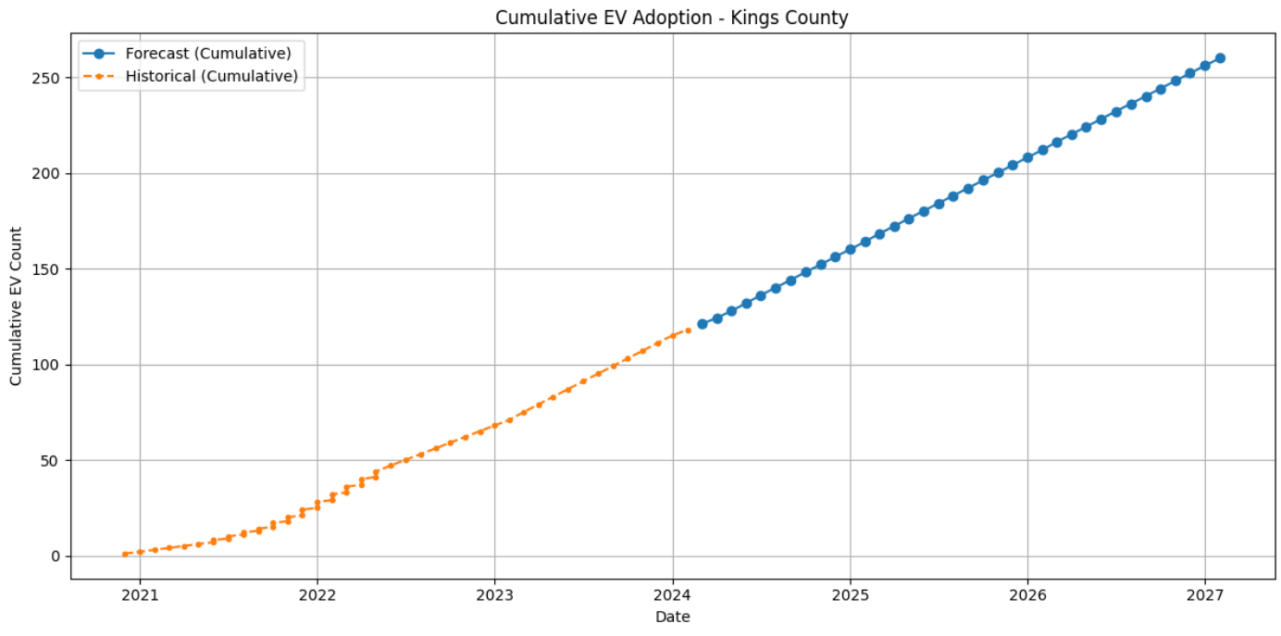
Screenshot of Output:
Streamlit interface
Forecasting model

Slide 8
Conclusion:
Developed a machine learning model to forecast EV adoption at the county level in Washington State.
Used historical EV data and socio-economic indicators for training the model..
Deployed the model using Streamlit for real-time, user-friendly forecasting.
Future Scope
Extend the model to cover all counties across the U.S. with scalable architecture.
Integrate real-time traffic, weather, and utility grid data for dynamic prediction.
Include policy impact simulations (e.g., tax benefits, rebates) in the forecast.
Develop mobile app integration for end-user accessibility.
Collaborate with government agencies to support policy planning and infrastructure deployment.

